Slide 1
Innovative practices for WRM in Croatia
Barbara Karleuša and Nevena Dragičević
University of Rijeka, Faculty of Civil Engineering
Workshop on innovative practices in the EU water sector barriers and opportunities/ 9th May 2019
This project has been funded with support from the European Commission. This publication reflects the views only of the author, and the Commission cannot be held responsible for any use which may be made of the information contained therein.

Slide 2
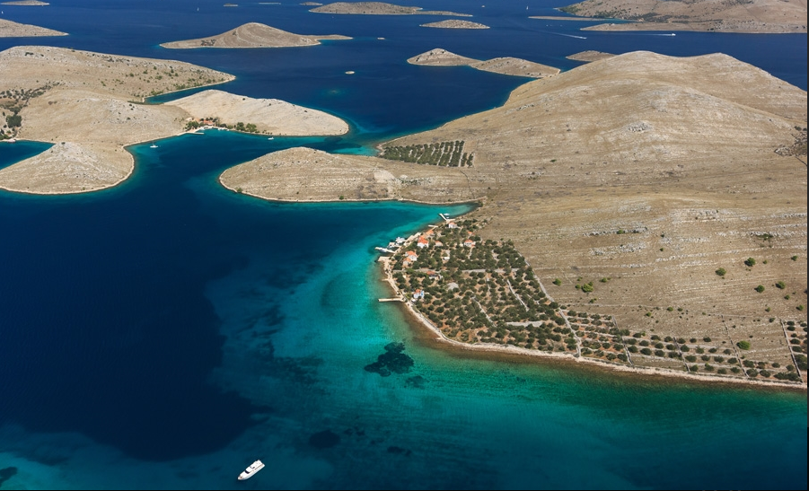
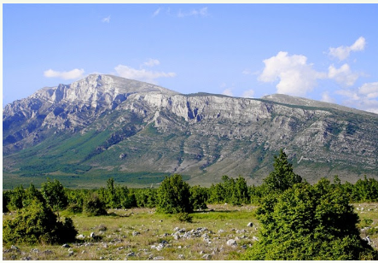
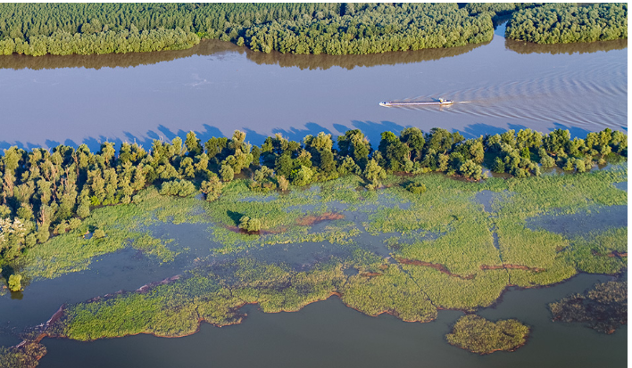
Croatia
Geographic position
Croatia occupies the largest part of the eastern coast of the Adriatic Sea, which is the northern most arm of the Mediterranean, extending furthest into the European landmass.
Croatia’s shoreline and numerous islands make up the majority of the Adriatic coastline.
The narrow Dinara Mountain Range separates the country’s Mediterranean region from its Central European continental part, which stretches from the eastern foothills of the Alps in the north-west to the banks of the Danube in the east, encompassing the southern part of the fertile Pannonian lowlands.
Strengthening of master curricula in water resources management
for the Western Balkans HEIs and stakeholders
www.swarm.ni.ac.rs

Slide 3
Croatia
Surface area
Croatia’s mainland covers an area of 56,594 km² and its coastal waters cover a surface area of 31,479 km².
Population
Croatia has 4,284,889 inhabitants.
Capital
With 790,017 inhabitants, Zagreb is the
economic, transport, cultural centre of the country.
Coastline length
The Croatian coastline extends 6,278 km, of which 1,880 km form up the mainland coastline, and 4,398 km the coastline of the islands, islets and rocks..
Rocks and reefs
Croatia has a total of 1,244 islands, islets
and rocks. The largest islands are Krk and
Cres. There are 47 inhabited islands.
Strengthening of master curricula in water resources management
for the Western Balkans HEIs and stakeholders
www.swarm.ni.ac.rs

Slide 4
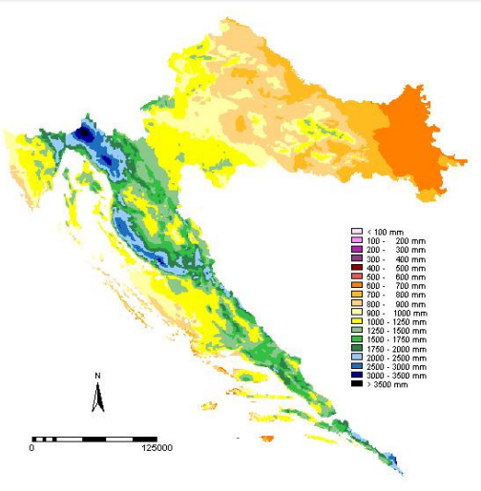
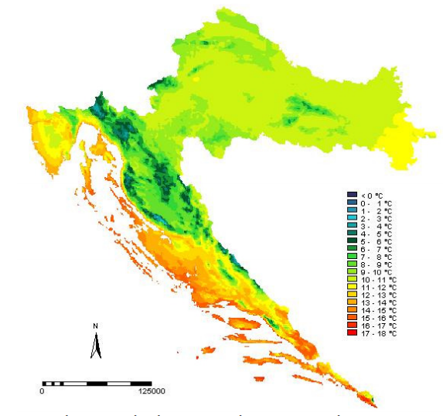
Temperature
Rainfall
Strengthening of master curricula in water resources management
for the Western Balkans HEIs and stakeholders
www.swarm.ni.ac.rs

Slide 5
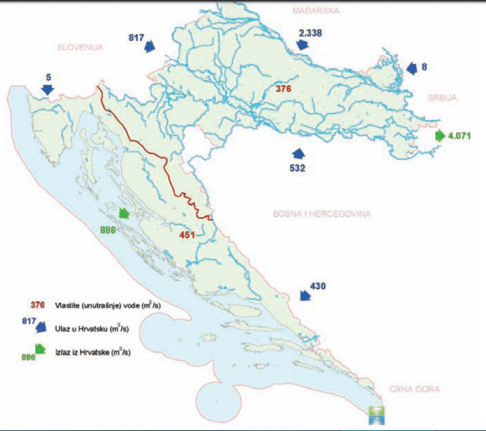
DANUBE RIVER BASIN
ADRIATIC BASIN
Strengthening of master curricula in water resources management
for the Western Balkans HEIs and stakeholders
www.swarm.ni.ac.rs

Slide 6
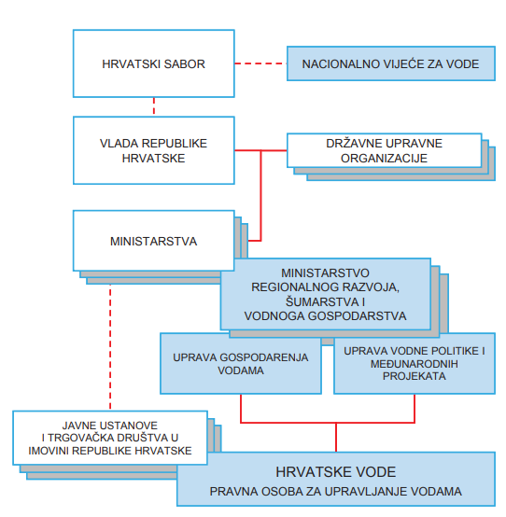
Water Management Framework in Croatia
https://www.voda.hr/sites/default/files/dokumenti/strategija_upravljanja_vodama.pdf
Strengthening of master curricula in water resources management
for the Western Balkans HEIs and stakeholders
www.swarm.ni.ac.rs

Slide 7
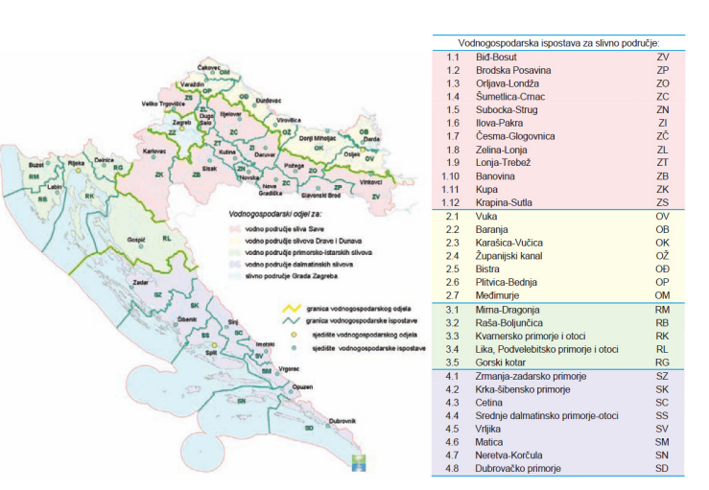
Strengthening of master curricula in water resources management
for the Western Balkans HEIs and stakeholders
www.swarm.ni.ac.rs

Slide 8
Legislation Framework
Water Management Strategy (Strategija upravljanja vodama)
Water Act
Water Management Financing Act (Zakon o financiranju vodnog gospodarstva)
Long-Term Programme for Construction(Višegodišnji programi gradnje)
Long-Term Programme for Construction of Water Regulation and Protection Structures for Amelioration Structures
Long-Term Programme for Construction of Water Utility Facilities
River basin management plan
Water management plan
Implementation Plan for Water Utility Directives
Financial plan
Strengthening of master curricula in water resources management
for the Western Balkans HEIs and stakeholders
www.swarm.ni.ac.rs
Notes:
A Strategija upravljanja vodama je dokument na temelju kojeg će se provoditi reforme vodnog sektora kako bi se dostigli europski standardi u upravljanju vodama, pa stoga čini osnovnu podlogu za postupne izmjene i dopune Zakona o vodama i Zakona o financiranju vodnoga gospodarstva i pripadajućih podzakonskih akata.
B Višegodišnji programi gradnje se izrađuju temeljem odredbi Zakona o vodama. Programe izrađuju Hrvatske vode u formi prijedloga, sukladno Strategiji upravljanja vodama („Narodne novine“, broj 91/08) i Planu upravljanja vodnim područjima („Narodne novine“, broj 82/13), a donosi ih Vlada Republike Hrvatske nakon provedene strateške procjene utjecaja na okoliš.
C Plan upravljanja vodnim područjima je planski dokument koji se donosi za razdoblje od 6 godina, nakon čega se mijenja i dopunjuje za razdoblje od narednih 6 godina. Zadnji plan je Plan upravljanja vodnim područjima za razdoblje od 2016 – 2021. godine. To je prvi plan koji sadrži i Plan upravljanja rizicima od poplava za to isto razdoblje
D Plan upravljanja vodama donosi se na godišnjoj razini. Zadnji plan je plan upravljanja vodama za 2019. godinu.
E - Plan provedbe vodno – komunalnih direktiva za razdoblje od 2010-2023

Slide 9
Innovative practices for WRM in Croatia
PROJECTs
Funded by
EU Structural Funds & Cohesion Fund
Ministry of Construction and Physical Planning
Croatian Waters
Water Utility Companies
Strengthening of master curricula in water resources management
for the Western Balkans HEIs and stakeholders
www.swarm.ni.ac.rs

Slide 10
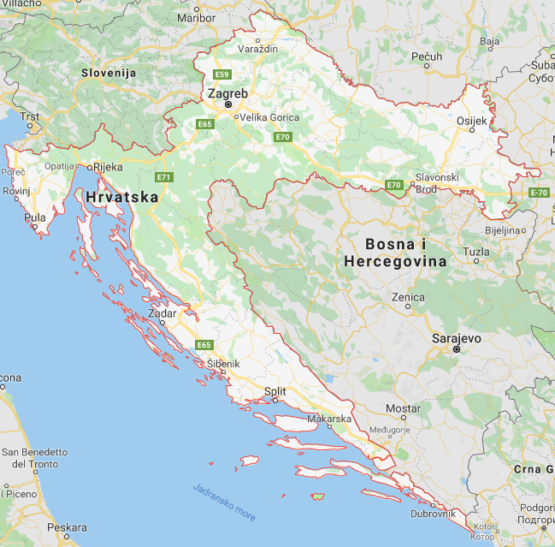
EU Structural Funds 2014. – 2020.
Croatia
CRO Financial budget 10,676 billion EUR
Operational programe Competitiveness and Cohesion 2014-2020
6,881 billion EUR
European Regional Development Fund
2,559 billion EUR
1,05 billion EUR
water and sewage utility
215 million EUR
flood protection
https://www.google.com/maps
Strengthening of master curricula in water resources management
for the Western Balkans HEIs and stakeholders
www.swarm.ni.ac.rs

Slide 11
Croatia
Strategical frame for using European Structural Funds:
Partnership Agreement
Operational Programs
4 programs
Common National rules and legislations
Law for establishing and institutional framework for use of European Structural Funds in the Republic of Croatia for the period 2014-2020
Regulation governing the competence of individual bodies for each European Structural Fund instrument
Strengthening of master curricula in water resources management
for the Western Balkans HEIs and stakeholders
www.swarm.ni.ac.rs

Slide 12
Operational Program Competitiveness and Cohesion 2014-2020
CLIMATE CHANGE AND RISK MANAGEMENT
ENVIROMENT PROTECTION AND RESURCES SUSTAINABILITY
Strengthening the disaster management system
Croatian Waters
150.000.000 EUR
National Protection and Rescue Directorate 65.000.000 EUR
Investment in water sector:
Development and improvement of public water supply systems
Development and improvement of water sewage systems
Croatian Waters
1.049.340.216 EUR
Strengthening of master curricula in water resources management
for the Western Balkans HEIs and stakeholders
www.swarm.ni.ac.rs

Slide 13
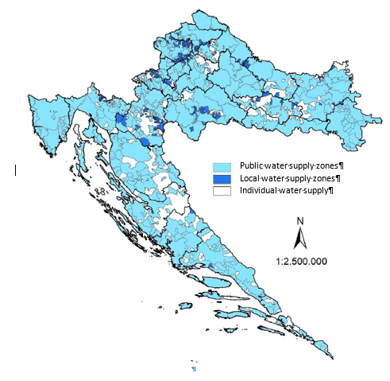
Water supply systems in Croatia
Water supply zones in Croatia
Water for less than 5000 inhabitants or less than 1000 m³/day is delivered in 180 public water supply zones (58,1%). In 184 local water supply zones (76,3%) water is delivered to more than 50 inhabitants.
In public water supply zones 83% use ground water, 10% surface water, 5% combination of surface and ground water, 2% brackish water.
551 water supply zones
310 public water supply zones,
241 local water supply zones) and
individual water supply zones
Strengthening of master curricula in water resources management
for the Western Balkans HEIs and stakeholders
www.swarm.ni.ac.rs

Slide 14
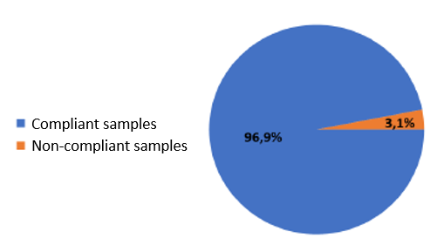
Water supply systems in Croatia
Results of drinking water analysis in all public water supply systems networks in 2017
WATER SUPPLY:
80% of population has access to public water supply system
20% has access to local water supply, or private wells, rainfall cisterns
Regional differences:
Average water loss in water supply systems 44%
Water quality – regional problems – water treatment plants
ADRIATIC
BASIN
DANUBE
RIVER
BASIN
Strengthening of master curricula in water resources management
for the Western Balkans HEIs and stakeholders
www.swarm.ni.ac.rs

Slide 15
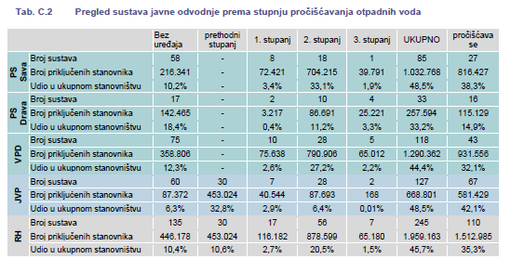
Collection of waste waters in Croatia
Strengthening of master curricula in water resources management
for the Western Balkans HEIs and stakeholders
www.swarm.ni.ac.rs

Slide 16
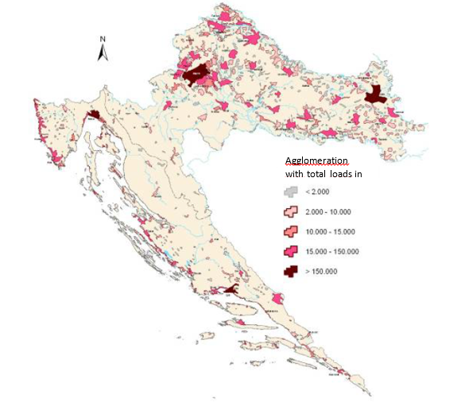
Collection of waste waters in Croatia
SEVAGE SYSTEMS:
Low access to public sewage systems (45.7% of population)
Regional differences (Dalmatia 31%)
35.3% is treated
Strengthening of master curricula in water resources management
for the Western Balkans HEIs and stakeholders
www.swarm.ni.ac.rs

Slide 17
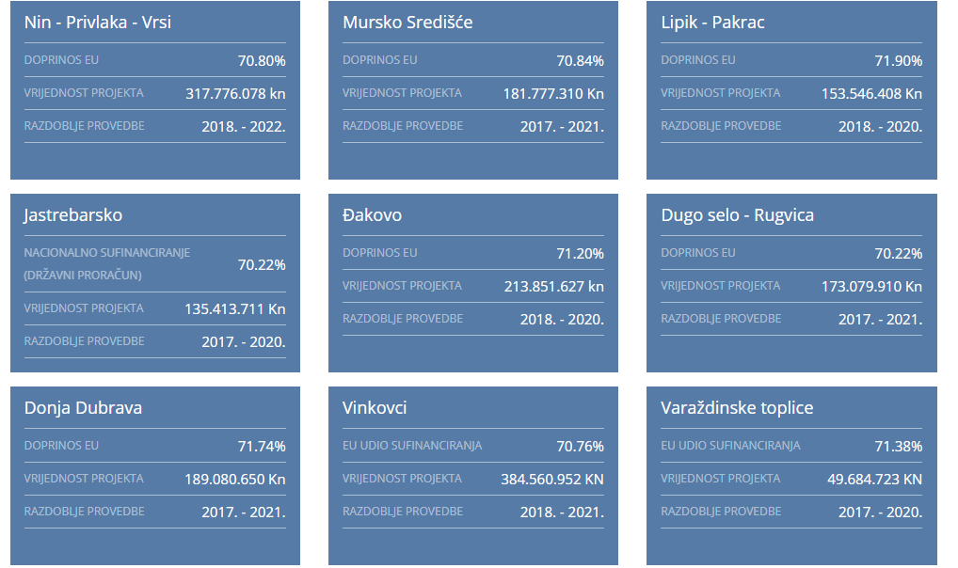
www.voda.hr
Strengthening of master curricula in water resources management
for the Western Balkans HEIs and stakeholders
www.swarm.ni.ac.rs

Slide 18
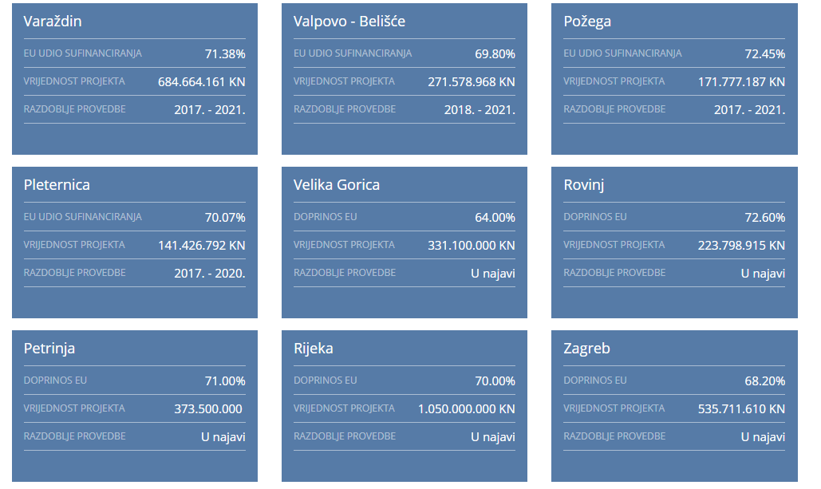
www.voda.hr
Strengthening of master curricula in water resources management
for the Western Balkans HEIs and stakeholders
www.swarm.ni.ac.rs

Slide 19
SUMMARY:
SUMMARY: |  | WATER SUPPLY | SEWAGE
PIPELINE | NEW | 9.76 km | 485.63 km
 | RECONSTRUCTION | 103.42 km | 82.92 km
RESERVOIR |  | 3 | /
PUMPING STATION |  | / | 204
PURIFICATION/CONDITIONING TREATMENT FACILITY |  | 1 | 11
Strengthening of master curricula in water resources management
for the Western Balkans HEIs and stakeholders
www.swarm.ni.ac.rs

Slide 20
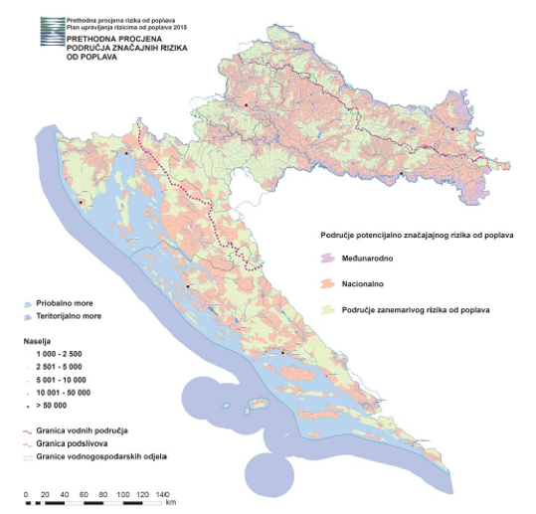
FLOOD PROTECTION
Areas with potentially significant flood risk
Strengthening of master curricula in water resources management
for the Western Balkans HEIs and stakeholders
www.swarm.ni.ac.rs

Slide 21
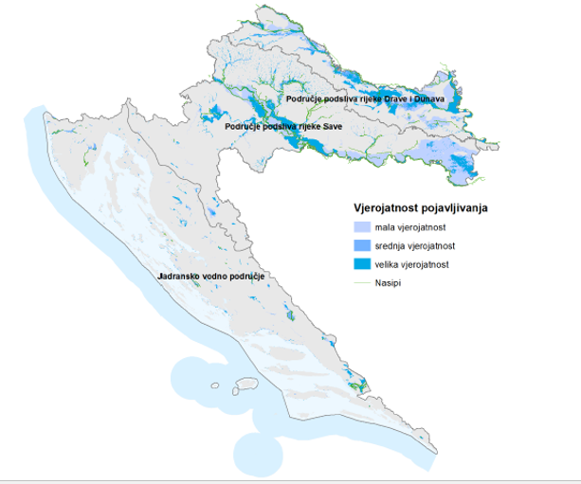
FLOOD PROTECTION
Flood hazard map for high, medium and low probability of occurrence
Strengthening of master curricula in water resources management
for the Western Balkans HEIs and stakeholders
www.swarm.ni.ac.rs

Slide 22
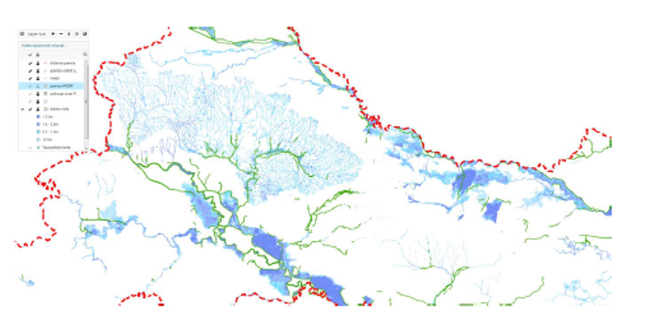
FLOOD PROTECTION
Flood hazard map for high probability of occurrence in the Danube river basin
Strengthening of master curricula in water resources management
for the Western Balkans HEIs and stakeholders
www.swarm.ni.ac.rs

Slide 23
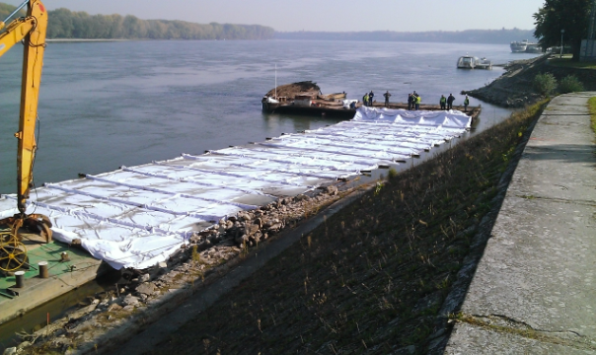
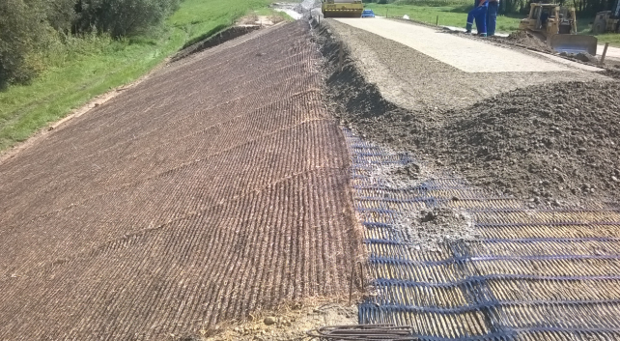
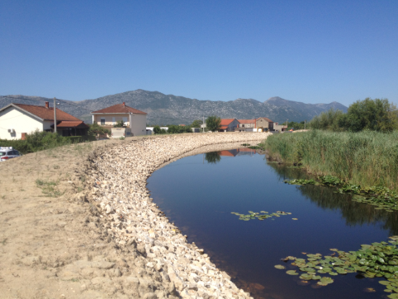
FLOOD PROTECTION PROJECT
www.voda.hr
Investments to upgrade, rebuild, complete and develop an existing flood protection systems to achieve a high level of protection of the target population on priority river basins in Croatian and thereby reducing flooding and their negative socio-economics impacts in Croatia
Strengthening of master curricula in water resources management
for the Western Balkans HEIs and stakeholders
www.swarm.ni.ac.rs

Slide 24
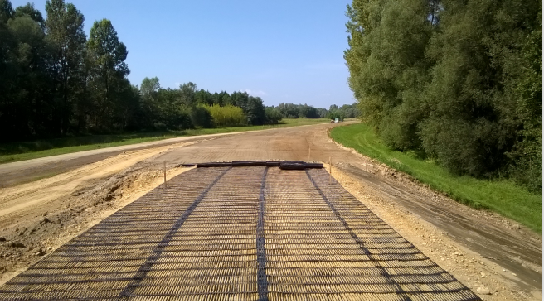
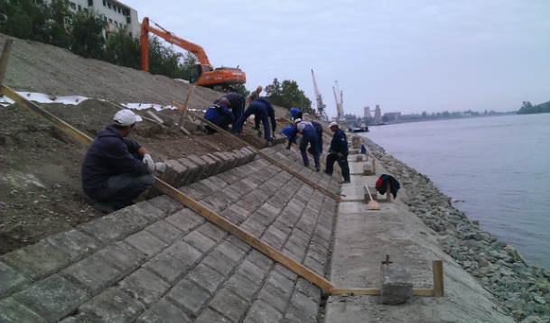
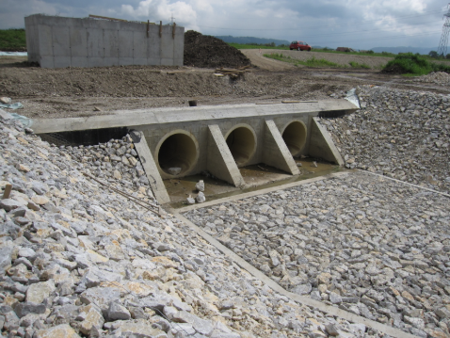
Ministry of Environmental Protection and Energy (under the jurisdiction)
Croatian Waters (project implementation Body)
Financial cost 80.000.000 EUR
50% funded by Counil of Europe Development Bank CEB
50% funded by Croatian Waters
www.voda.hr
Strengthening of master curricula in water resources management
for the Western Balkans HEIs and stakeholders
www.swarm.ni.ac.rs

Slide 25
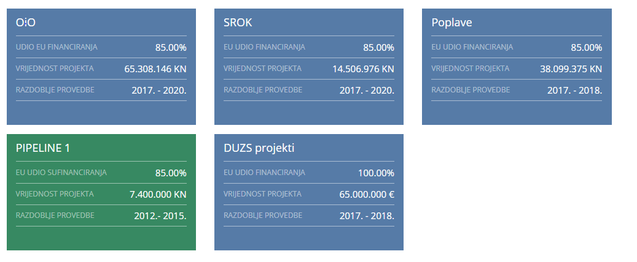
CLIMATE CHANGE AND RISK MANAGEMENT
www.voda.hr
Strengthening of master curricula in water resources management
for the Western Balkans HEIs and stakeholders
www.swarm.ni.ac.rs

Slide 26
Thank You for Your attention!
Strengthening of master curricula in water resources management
for the Western Balkans HEIs and stakeholders
www.swarm.ni.ac.rs

